Slide 1
Plan for the day
Have a look at G(T,P) thermodynamic surfaces
Gibbs energy and the 2nd Law
Equilibrium and the connection to Clausius-Clapeyron
Equilibrium and the connection to Clapeyron
Thermodynamics of fossil fuel burning

Slide 2
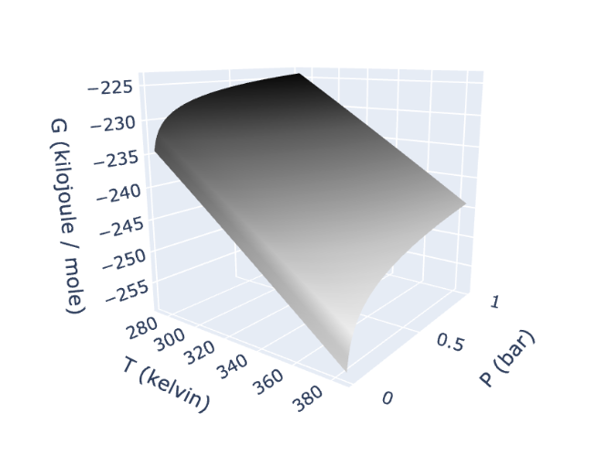
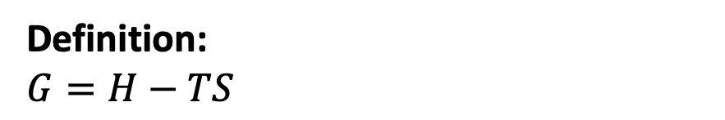
1. G(T,P) thermodynamic surfaces
Definition:
$G=H−TS$
Gas
Why does G slope down in the temperature direction, up in the pressure direction?

Slide 3
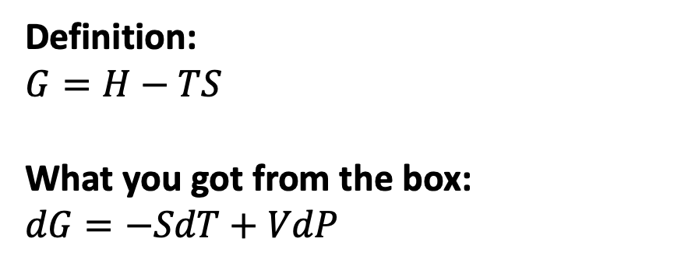
1. G(T,P) thermodynamic surfaces
Definition:
$G=H−TS$
What you got from the box:
$dG=−SdT+VdP$
Gas
Why does G slope down in the temperature direction, up in the pressure direction?

Slide 4
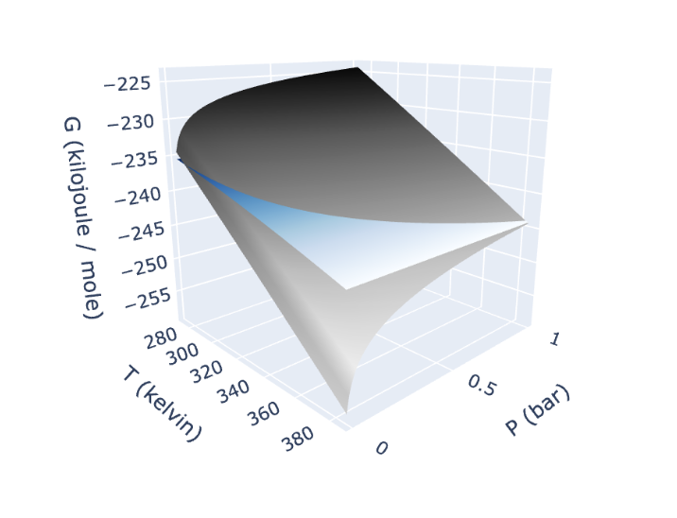
1. G(T,P) thermodynamic surfaces
Definition:
$G=H−TS$
What you got from the box:
$dG=−SdT+VdP$
Liquid
Gas
Why is the gas curve steeper in the temperature direction?

Slide 5
1. G(T,P) thermodynamic surfaces
Definition:
$G=H−TS$
What you got from the box:
$dG=−SdT+VdP$
Liquid
Gas
Why is the gas curve steeper in the temperature direction?
Because $S_{gas}>S_{liq}$

Slide 6
1. G(T,P) thermodynamic surfaces
Definition:
$G=H−TS$
What you got from the box:
$dG=−SdT+VdP$
Liquid
Gas
Why is the gas curve also steeper in the pressure direction?

Slide 7
1. G(T,P) thermodynamic surfaces
Definition:
$G=H−TS$
What you got from the box:
$dG=−SdT+VdP$
Liquid
Gas
Why is the gas curve also steeper in the pressure direction?
Because $V_{gas}>V_{liq}$

Slide 8
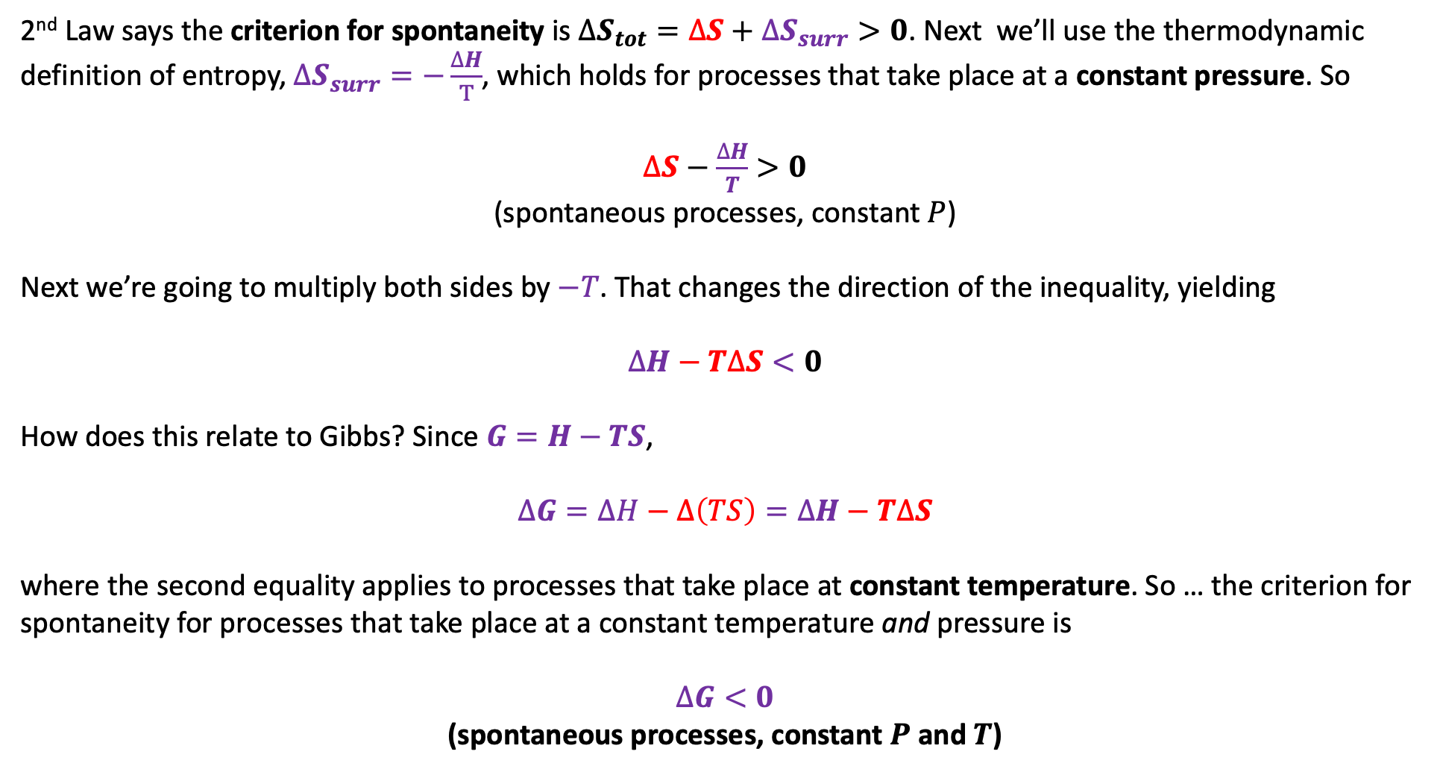
2. G(T,P) thermodynamic surfaces and the 2nd Law
2nd Law says the criterion for spontaneity is $∆S_{tot}=∆S+∆S_{surr}>0$. Next we’ll use the thermodynamic definition of entropy, $∆S_{surr}=−\frac{∆H}{T}$, which holds for processes that take place at a constant pressure. So
$∆S−\frac{∆H}{T}>0$
(spontaneous processes, constant $P$)
Next we’re going to multiply both sides by $−T$. That changes the direction of the inequality, yielding
$$∆H−T∆S<0$$
How does this relate to Gibbs? Since $G=H−TS$,
$$∆G=∆H−∆\left(TS\right)=∆H−T∆S$$
where the second equality applies to processes that take place at constant temperature. So … the criterion for spontaneity for processes that take place at a constant temperature and pressure is
$∆G<0$
(spontaneous processes, constant $P$ and $T$)

Slide 9
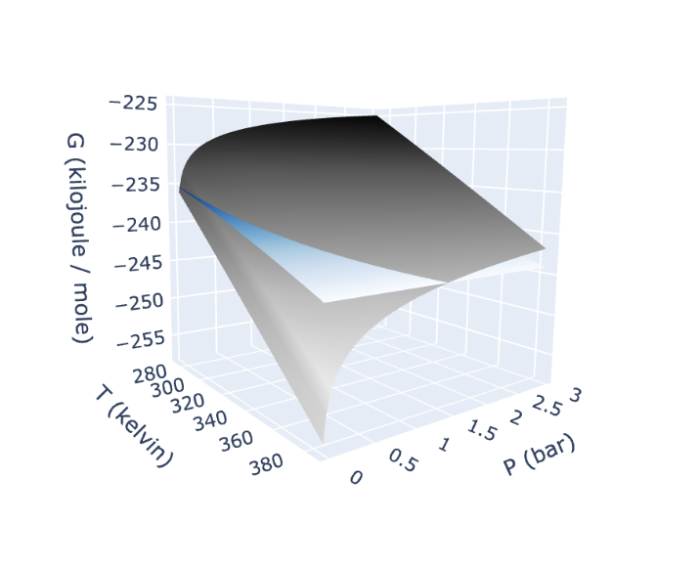
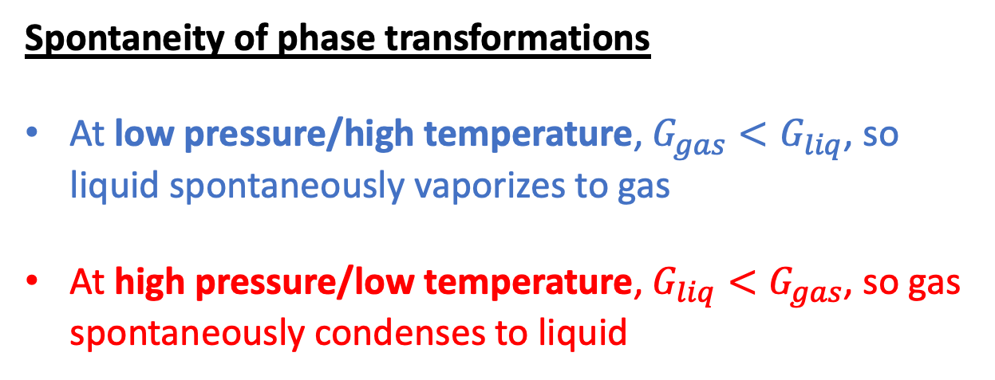
2. G(T,P) thermodynamic surfaces and the 2nd Law
Spontaneity of phase transformations
At low pressure/high temperature, $G_{gas}<G_{liq}$, so liquid spontaneously vaporizes to gas
At high pressure/low temperature, $G_{liq}<G_{gas}$, so gas spontaneously condenses to liquid
Liquid
Gas
gas
gas
liquid

Slide 10
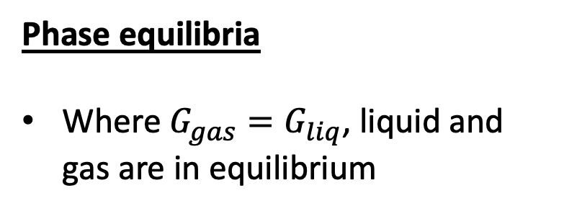
3. Equilibrium and connection to Clausius-Clapeyron
Phase equilibria
Where $G_{gas}=G_{liq}$, liquid and gas are in equilibrium
Liquid
Gas

Slide 11
3. Equilibrium and connection to Clausius-Clapeyron
Phase equilibria
Where $G_{gas}=G_{liq}$, liquid and gas are in equilibrium
Liquid
Gas

Slide 12
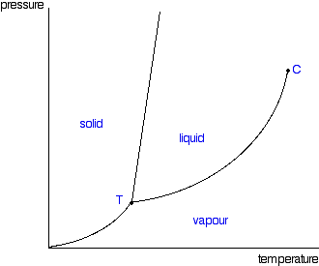
3. Equilibrium and connection to Clausius-Clapeyron
Phase equilibria
Where $G_{gas}=G_{liq}$, liquid and gas are in equilibrium
Liquid
Gas
P
T

Slide 13
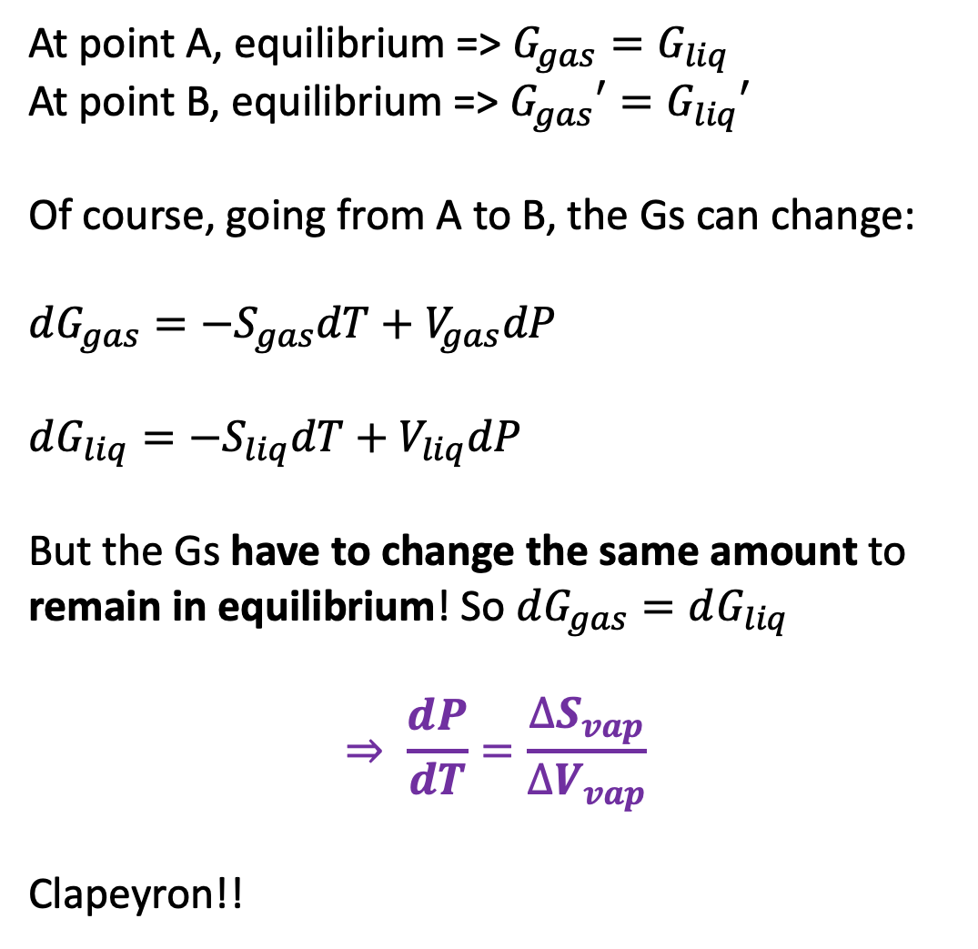
4. Equilibrium and connection to Clapeyron
At point A, equilibrium => $G_{gas}=G_{liq}$
At point B, equilibrium => $G_{gas}′=G_{liq}′$
Of course, going from A to B, the Gs can change:
$dG_{gas}=−S_{gas}dT+V_{gas}dP$
$dG_{liq}=−S_{liq}dT+V_{liq}dP$
But the Gs have to change the same amount to remain in equilibrium! So $dG_{gas}=dG_{liq}$
$$⇒ \frac{dP}{dT}=\frac{∆S_{vap}}{∆V_{vap}}$$
Clapeyron!!
A
B
Liquid
A
Gas
B

Slide 14
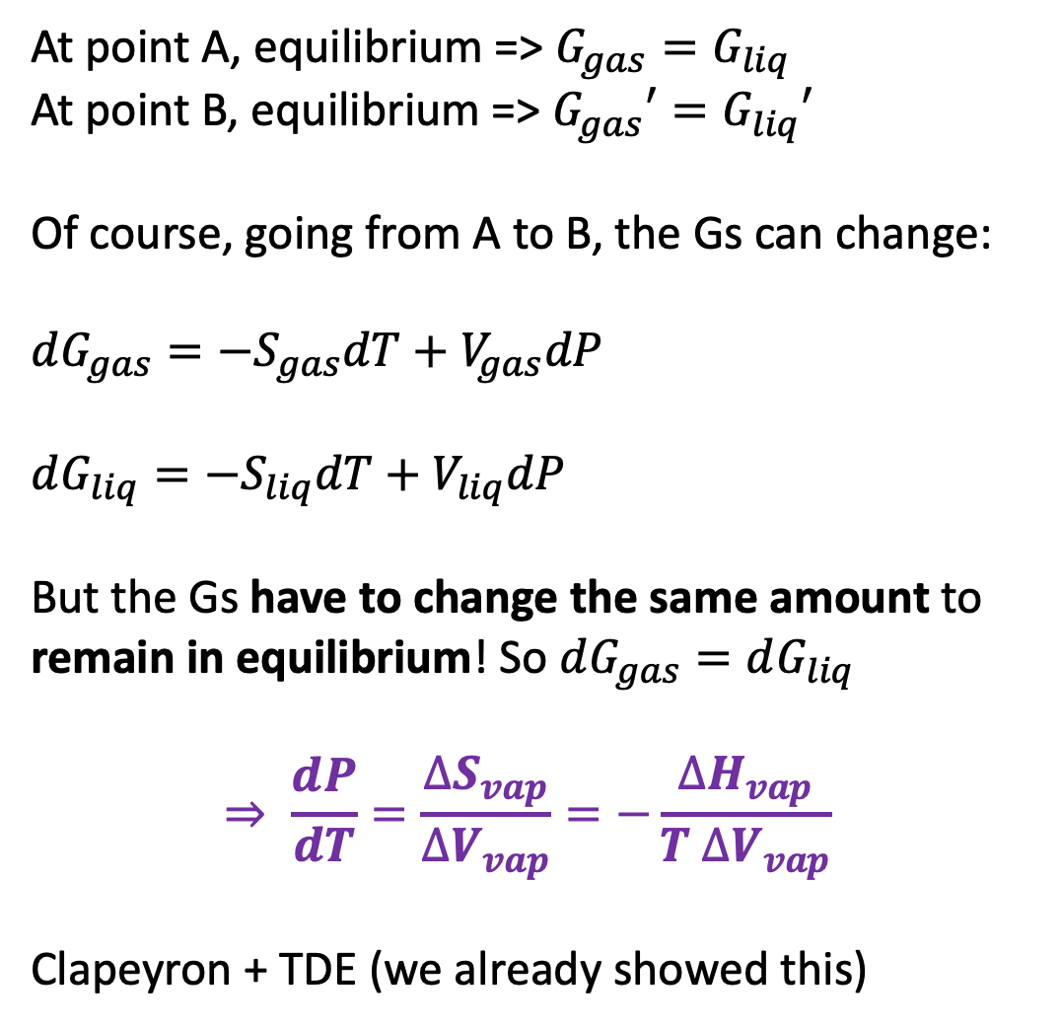
4. Equilibrium and connection to Clapeyron
At point A, equilibrium => $G_{gas}=G_{liq}$
At point B, equilibrium => $G_{gas}′=G_{liq}′$
Of course, going from A to B, the Gs can change:
$dG_{gas}=−S_{gas}dT+V_{gas}dP$
$dG_{liq}=−S_{liq}dT+V_{liq}dP$
But the Gs have to change the same amount to remain in equilibrium! So $dG_{gas}=dG_{liq}$
$$⇒ \frac{dP}{dT}=\frac{∆S_{vap}}{∆V_{vap}}=−\frac{∆H_{vap}}{T ∆V_{vap}}$$
Clapeyron + TDE (we already showed this)
A
B
Liquid
A
Gas
B

Slide 15


5. Gibbs energy of burning a mole of coal: the benefit
$$C\left(s\right)+O_{2}\left(g\right)→CO_{2}\left(g\right)$$
Benefit:
Heat fuels an electricity-generating power plant
Furnace

Slide 16
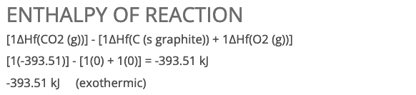
5. Gibbs energy of burning a mole of coal: the benefit
$$C\left(s\right)+O_{2}\left(g\right)→CO_{2}\left(g\right)$$
Benefit:
Heat fuels an electricity-generating power plant
Furnace

Slide 17
5. Gibbs energy of burning a mole of coal: the benefit
$$C\left(s\right)+O_{2}\left(g\right)→CO_{2}\left(g\right)$$
Benefit:
Heat fuels an electricity-generating power plant
This is the useful electrical energy (electricity) we get from it
Furnace

Slide 18
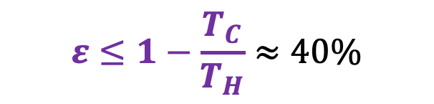
5. Gibbs energy of burning a mole of coal: the benefit
$$C\left(s\right)+O_{2}\left(g\right)→CO_{2}\left(g\right)$$
Benefit:
Heat fuels an electricity-generating power plant
$$ε≤1−\frac{T_{C}}{T_{H}}≈40\%$$
Furnace

Slide 19

5. Gibbs energy of burning a mole of coal: the benefit
$$C\left(s\right)+O_{2}\left(g\right)→CO_{2}\left(g\right)$$
Benefit:
Heat fuels an electricity-generating power plant
394 kJ/mol
160 kJ/mol
$40\%$ of 394 is 160
Furnace

Slide 20

5. Gibbs energy of burning a mole of coal: the cost
Goal: Find $∆G_{dil}$ for $CO_{2}\left(stack\right)→CO_{2}\left(atmos\right)$
$$V_{final}=4.2 x {10}^{18} m^{3}$$
Furnace

Slide 21


5. Gibbs energy of burning a mole of coal: the cost
Goal: Find $∆G_{dil}$ for $CO_{2}\left(stack\right)→CO_{2}\left(atmos\right)$
$$V_{final}=4.2 x {10}^{18} m^{3}$$
$$∆S_{dil}=R\ln{(\frac{V_{final}}{V_{initial}})}$$
$V_{initial}=\frac{RT}{P}≈24 L$
Furnace

Slide 22
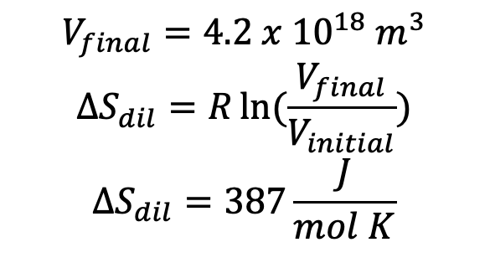
5. Gibbs energy of burning a mole of coal: the cost
Goal: Find $∆G_{dil}$ for $CO_{2}\left(stack\right)→CO_{2}\left(atmos\right)$
$$V_{final}=4.2 x {10}^{18} m^{3}$$
$$∆S_{dil}=R\ln{(\frac{V_{final}}{V_{initial}})}$$
$$∆S_{dil}=387\frac{J}{mol K}$$
$V_{initial}=\frac{RT}{P}≈24 L$
Furnace

Slide 23

5. Gibbs energy of burning a mole of coal: the cost
Goal: Find $∆G_{dil}$ for $CO_{2}\left(stack\right)→CO_{2}\left(atmos\right)$
$$V_{final}=4.2 x {10}^{18} m^{3}$$
$$∆S_{dil}=R\ln{(\frac{V_{final}}{V_{initial}})}$$
$$∆S_{dil}=387\frac{J}{mol K}$$
$$∆G_{dil}=−115\frac{kJ}{mol}$$
$V_{initial}=\frac{RT}{P}≈24 L$
Furnace

Slide 24
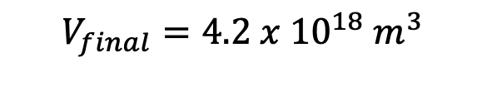
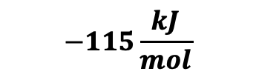
5. Gibbs energy of burning a mole of coal: the cost
Goal: Find $∆G_{dil}$ for $CO_{2}\left(stack\right)→CO_{2}\left(atmos\right)$
$$V_{final}=4.2 x {10}^{18} m^{3}$$
$V_{initial}=\frac{RT}{P}≈24 L$
$$−115\frac{kJ}{mol}$$
Furnace

Slide 25
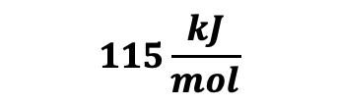
5. Gibbs energy of burning a mole of coal: the cost
Goal: Find $∆G_{dil}$ for $CO_{2}\left(stack\right)→CO_{2}\left(atmos\right)$
$$V_{final}=4.2 x {10}^{18} m^{3}$$
$V_{initial}=\frac{RT}{P}≈24 L$
Cost to somebody in the future
$$115\frac{kJ}{mol}$$
Furnace

Slide 26
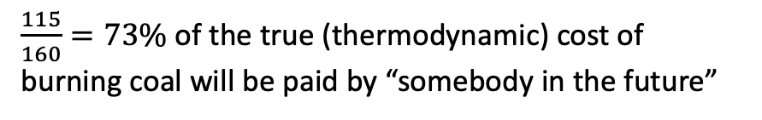
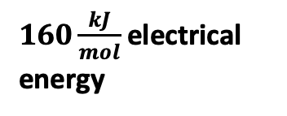
5. Gibbs energy of burning a mole of coal: the cost
Goal: Find $∆G_{dil}$ for $CO_{2}\left(stack\right)→CO_{2}\left(atmos\right)$
$$V_{final}=4.2 x {10}^{18} m^{3}$$
$V_{initial}=\frac{RT}{P}≈24 L$
160 kJ/mol
Cost to somebody in the future
Benefit to us in the present
$$115\frac{kJ}{mol}$$
$160\frac{kJ}{mol}$electrical energy
Furnace
$\frac{115}{160}=73\%$ of the true (thermodynamic) cost of burning coal will be paid by “somebody in the future”

